Slide 1
Detecting Playing Card Edges and Corners in Real-World Scenes Using Classical Computer Vision
Developed By
Mounika Teppola & Bala Swapnika Gopi

Slide 2
What is this Project About?
This project focuses on detecting the edges and corners of playing cards using simple computer vision techniques. Instead of using advanced machine learning models, we rely on classical methods that analyze image structure such as boundaries and sharp points.
The goal is to understand how these methods perform in real-world environments where images contain clutter, lighting variations, and multiple objects.

Slide 3
Why is this Important?
Edge and corner detection helps computers understand shapes and structures in images.
However, real-world images are often messy and complex. This project helps us analyze how well these basic techniques work when conditions are not ideal, such as in cluttered scenes or uneven lighting.

Slide 4


Dataset
We created our own dataset with over 150 images and 3 videos of playing cards in real-world scenes.
These scenes include:
Cards on clean backgrounds (baseline cases)
Cards on cluttered or textured surfaces
Different angles and rotations
Uneven or low lighting conditions
Partially occluded cards
Motion blur in video frames
Different scales (varying distances)
Fig 1 : Rotation and scaling
Fig 2 : Lighting, shadows
and partial occlusion

Slide 5
System Pipeline (How It Works)
Harris Corner
Input
(Image/Video)
Detected
Output
Preprocessing
Canny Edge
Shi Tomasi
Fig 3 : Flowchart

Slide 6
Methods Used
We use three main techniques to analyze the image and extract meaningful features.
Canny Edge Detection: Detects object boundaries by identifying sharp intensity changes, but may also capture edges from background objects in cluttered scenes.
Harris Corner Detection: Detects corner-like points by finding regions with intensity changes in multiple directions, often producing many points including noise.
Shi-Tomasi Detection: Selects the strongest and most reliable corner points, resulting in cleaner and more stable detections.
Each of these methods highlights different aspects of the image, allowing us to better understand and compare how features are detected in real-world conditions.

Slide 7
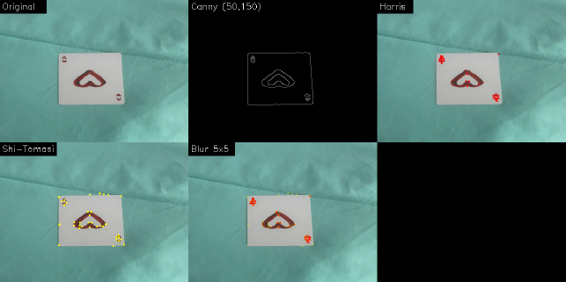
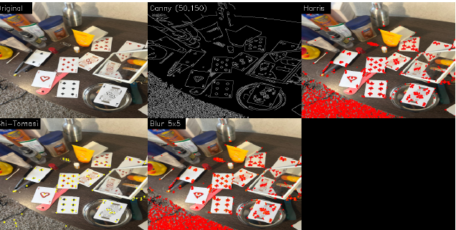
Output Visualization
Fig 4 : Baseline output for a clean background scene.
Fig 5 : Baseline output for a cluttered scene.
The results show that in clean background scenes, the edges and corners of the playing cards are clearly detected, with minimal interference from surrounding areas. In cluttered scenes, however, the detectors respond to both the cards and nearby objects.

Slide 8
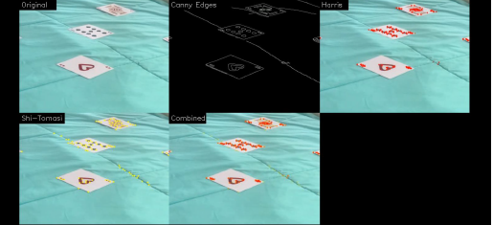
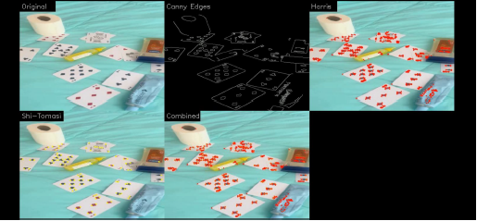
Key Observations
In simple scenes:
Card edges are clearly detected
Corner detection is accurate
In cluttered scenes:
Many unwanted edges appear
Corner points spread across the image
Detection becomes harder to interpret
Fig 6 : Simple Scene
Fig 7 : Cluttered Scene

Slide 9
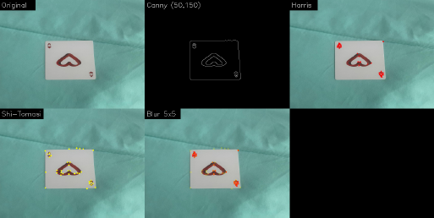
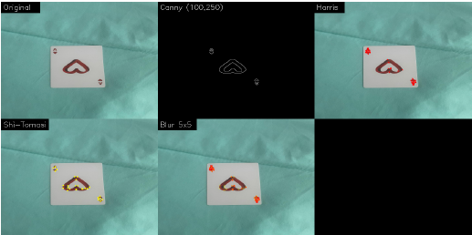
Effect of Parameter Tuning
We tested different settings such as blur and threshold values.
Lower thresholds detect more edges but increase noise
Higher thresholds reduce noise but may miss important edges
Moderate settings give the best balance
However, these adjustments do not completely remove background interference.
(a) : (50, 150)
(b) : (100, 250)
Fig 8 : Effect of Canny threshold settings in a clean background scene.

Slide 10
Limitations
These methods are not object-aware, meaning they detect edges and corners everywhere in the image.
This leads to:
Detection of background objects
Extra corner points inside cards
Difficulty isolating only the playing cards

Slide 11
Conclusion
Classical computer vision techniques such as Canny, Harris, and Shi-Tomasi are effective for detecting basic features like edges and corners in images.
They perform well in simple environments but struggle to focus only on the playing cards in complex, cluttered scenes.
Overall, these methods are fast and useful for feature extraction, but they are limited when precise object-level detection is required.

